Slide 1

CSE221: Algorithms
Minimum Spanning Tree
Prepared by: A B M Muntasir Rahman [MUNR]

Slide 2
Spanning Tree
A spanning tree is a subgraph/tree of a connected, undirected graph that:
Includes all the vertices of the original graph.
Is a tree (i.e. no disjoint vertices and has no cycles).
Uses only a subset of edges.
If the graph has N vertices, then any spanning tree of the graph will exactly have N - 1 edges.
A graph can have many different spanning trees.

Slide 3
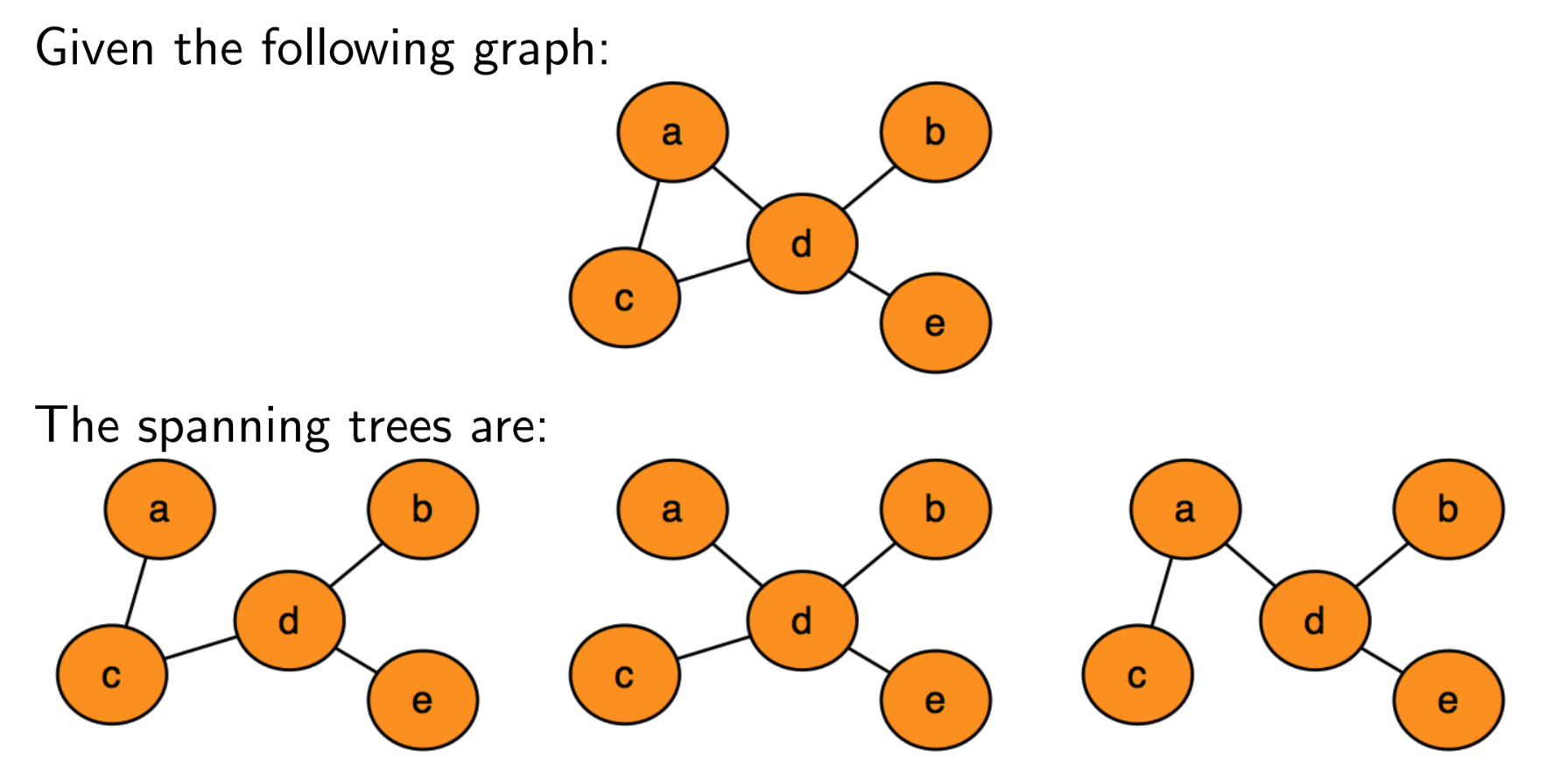
Spanning Tree

Slide 4
Minimum Spanning Tree (MST)
If the graph is weighted (i.e. each edge has a cost/weight), then a minimum spanning tree (MST) is:
A spanning tree with minimum total edge weight among all possible spanning trees.
An MST may not be unique if multiple spanning trees have the same total weight.

Slide 5
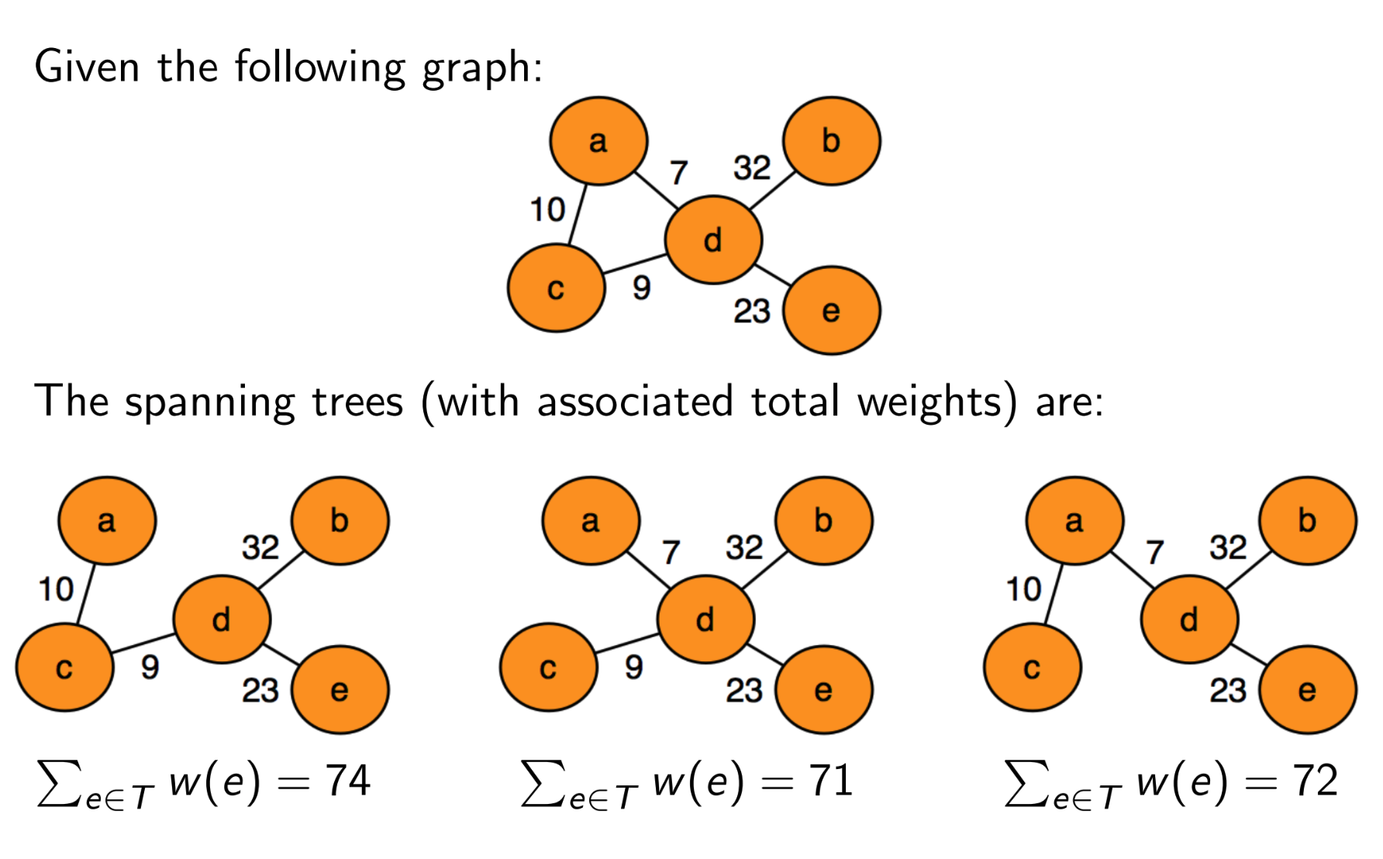
Minimum Spanning Tree (MST)

Slide 6
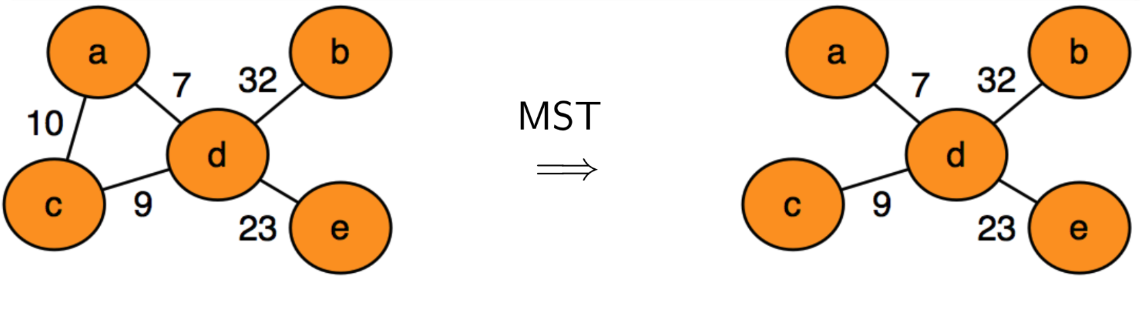
Minimum Spanning Tree (MST)
Of the spanning trees we got in the previous slide, the second spanning tree has the least overall weight - and it is the Minimum Spanning Tree!

Slide 7
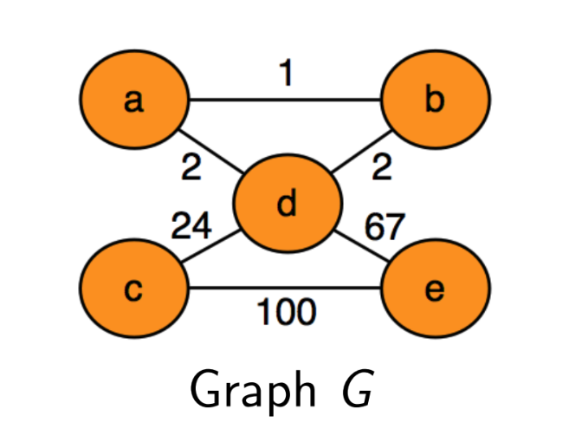
Uniqueness of MST
The minimum cost spanning tree may not be unique!

Slide 8
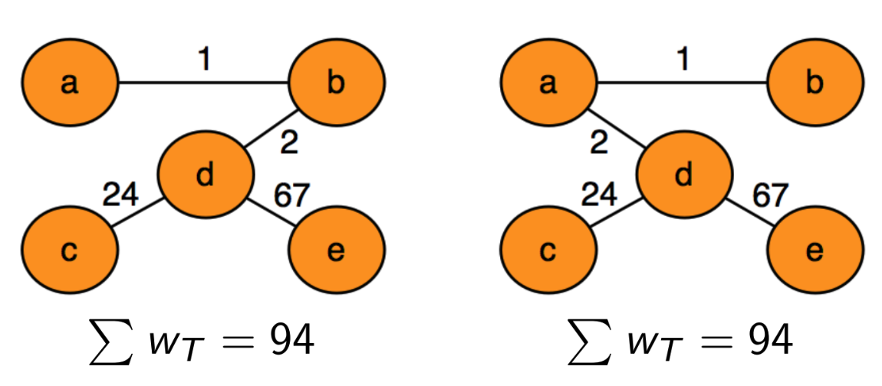
Uniqueness of MST
However, if the weights are all distinct (i.e. w(u_{i}, v_{j}) ≠ w(u_{k}, v_{l})), then it is indeed unique.

Slide 9
Applications of MST
Network Design (Telecommunication networks/Electrical grids etc.)
Transportation & Road Networks (Planning airline routines/delivery networks/trip itinerary etc.)
Circuit Design (Minimizing total length of wiring) etc.
In short: MST is applied anywhere we want to connect things efficiently while minimizing cost and avoiding cycles.

Slide 10
How to find MST?
There are two algorithms: Prim’s Algorithm and Kruskal’s Algorithm which can find MST in a weighted and undirected graph.
In this course, we will discuss about Kruskal’s Algorithm only.

Slide 11
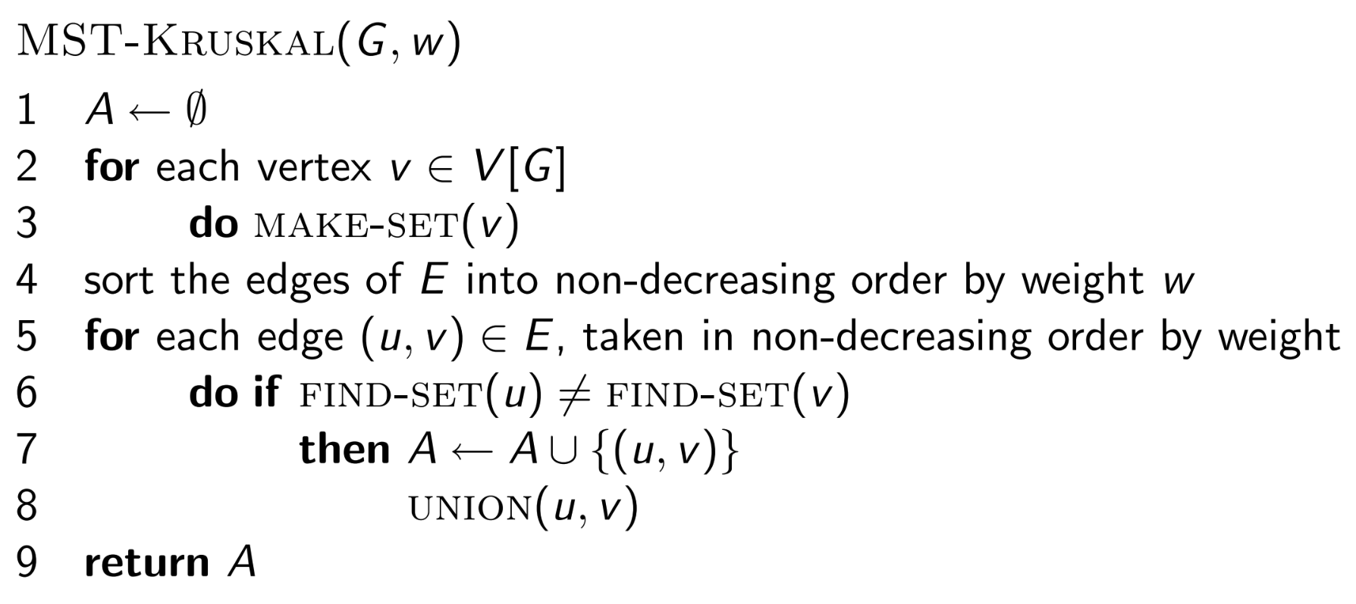
Kruskal’s Algorithm

Slide 12
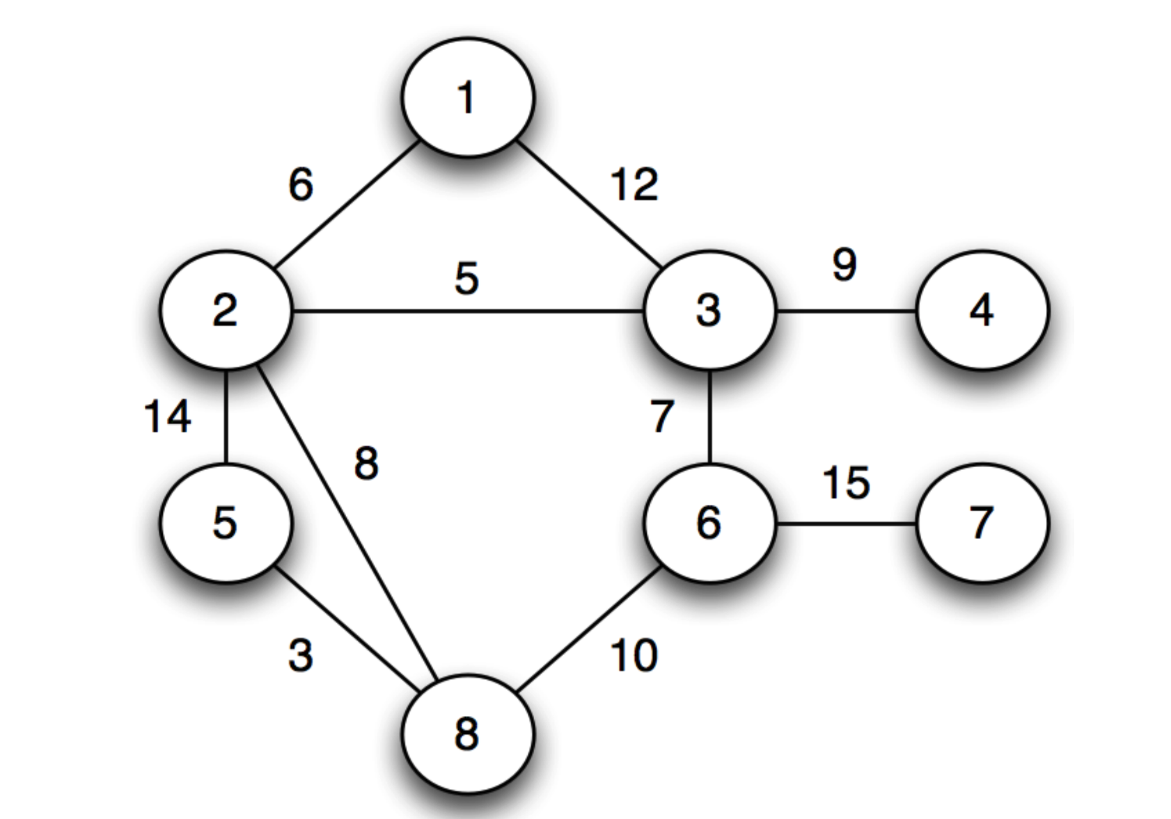
Kruskal’s Algorithm (Simulation)

Slide 13
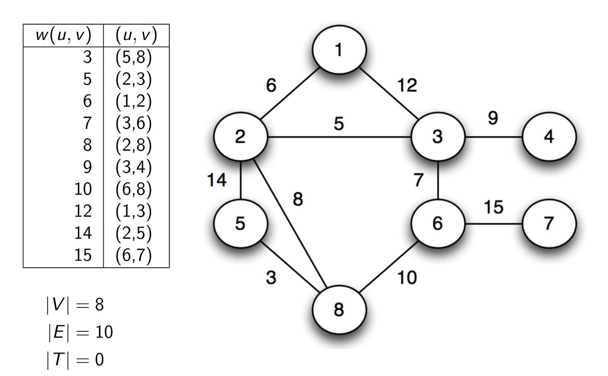
Kruskal’s Algorithm (Simulation)

Slide 14
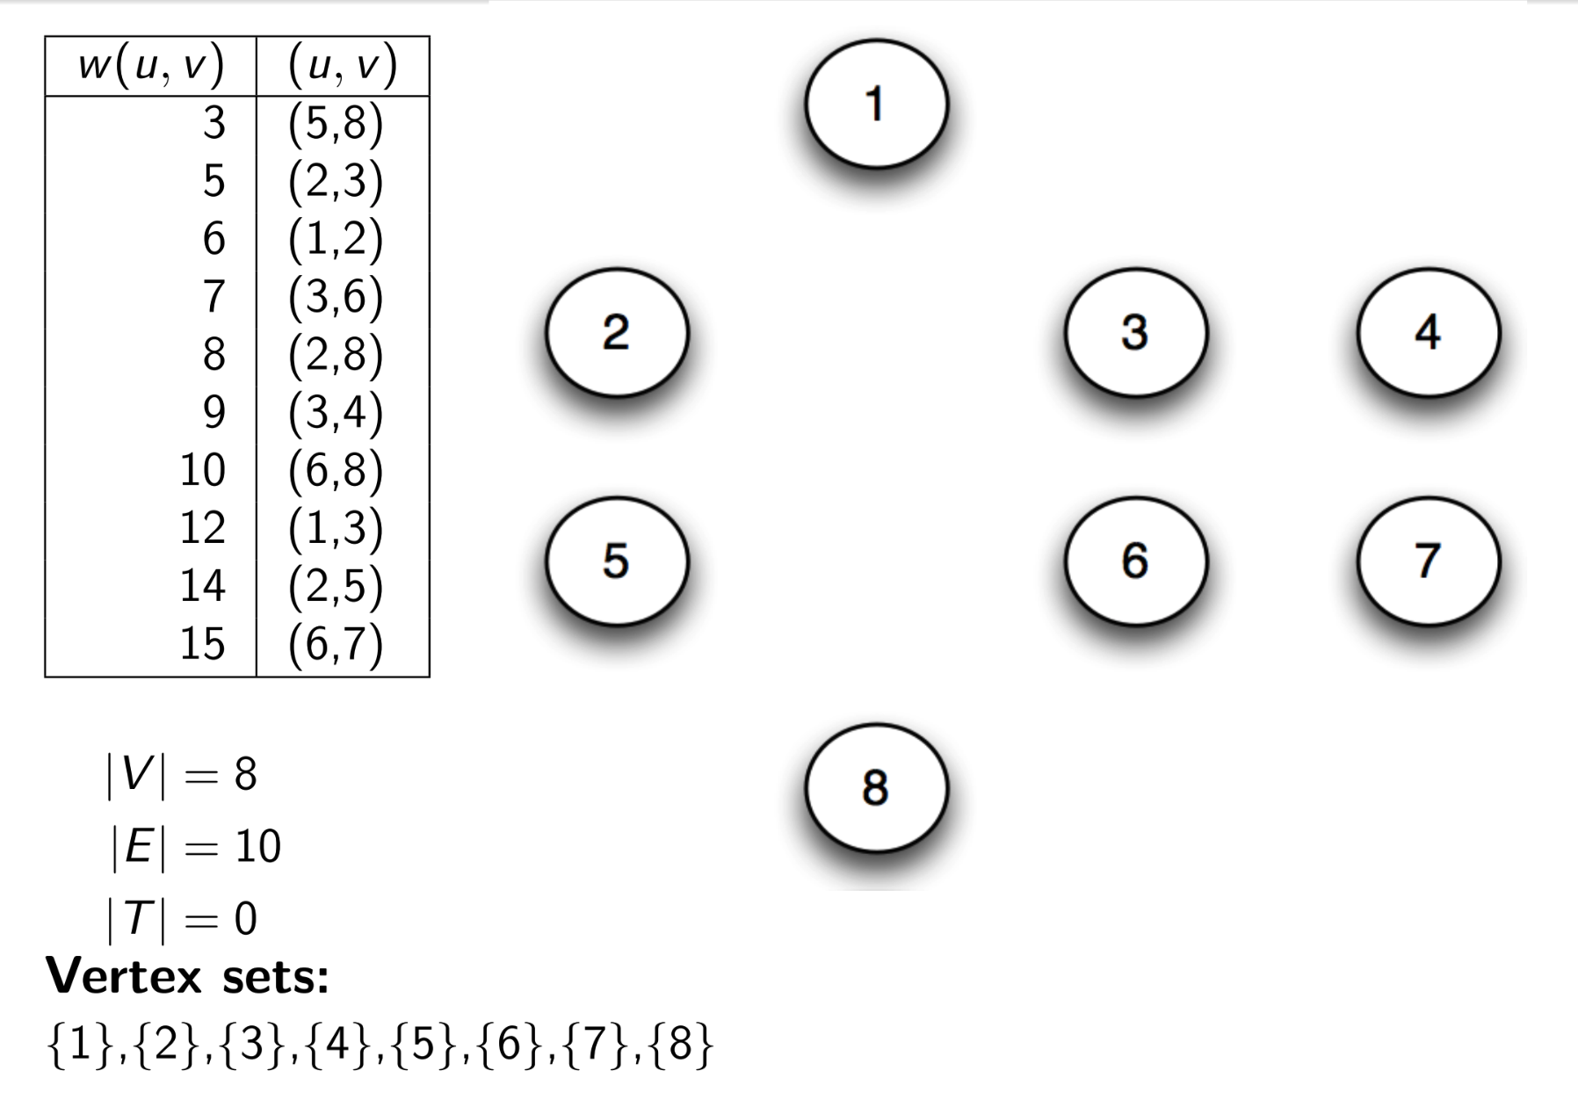
Kruskal’s Algorithm (Simulation)

Slide 15
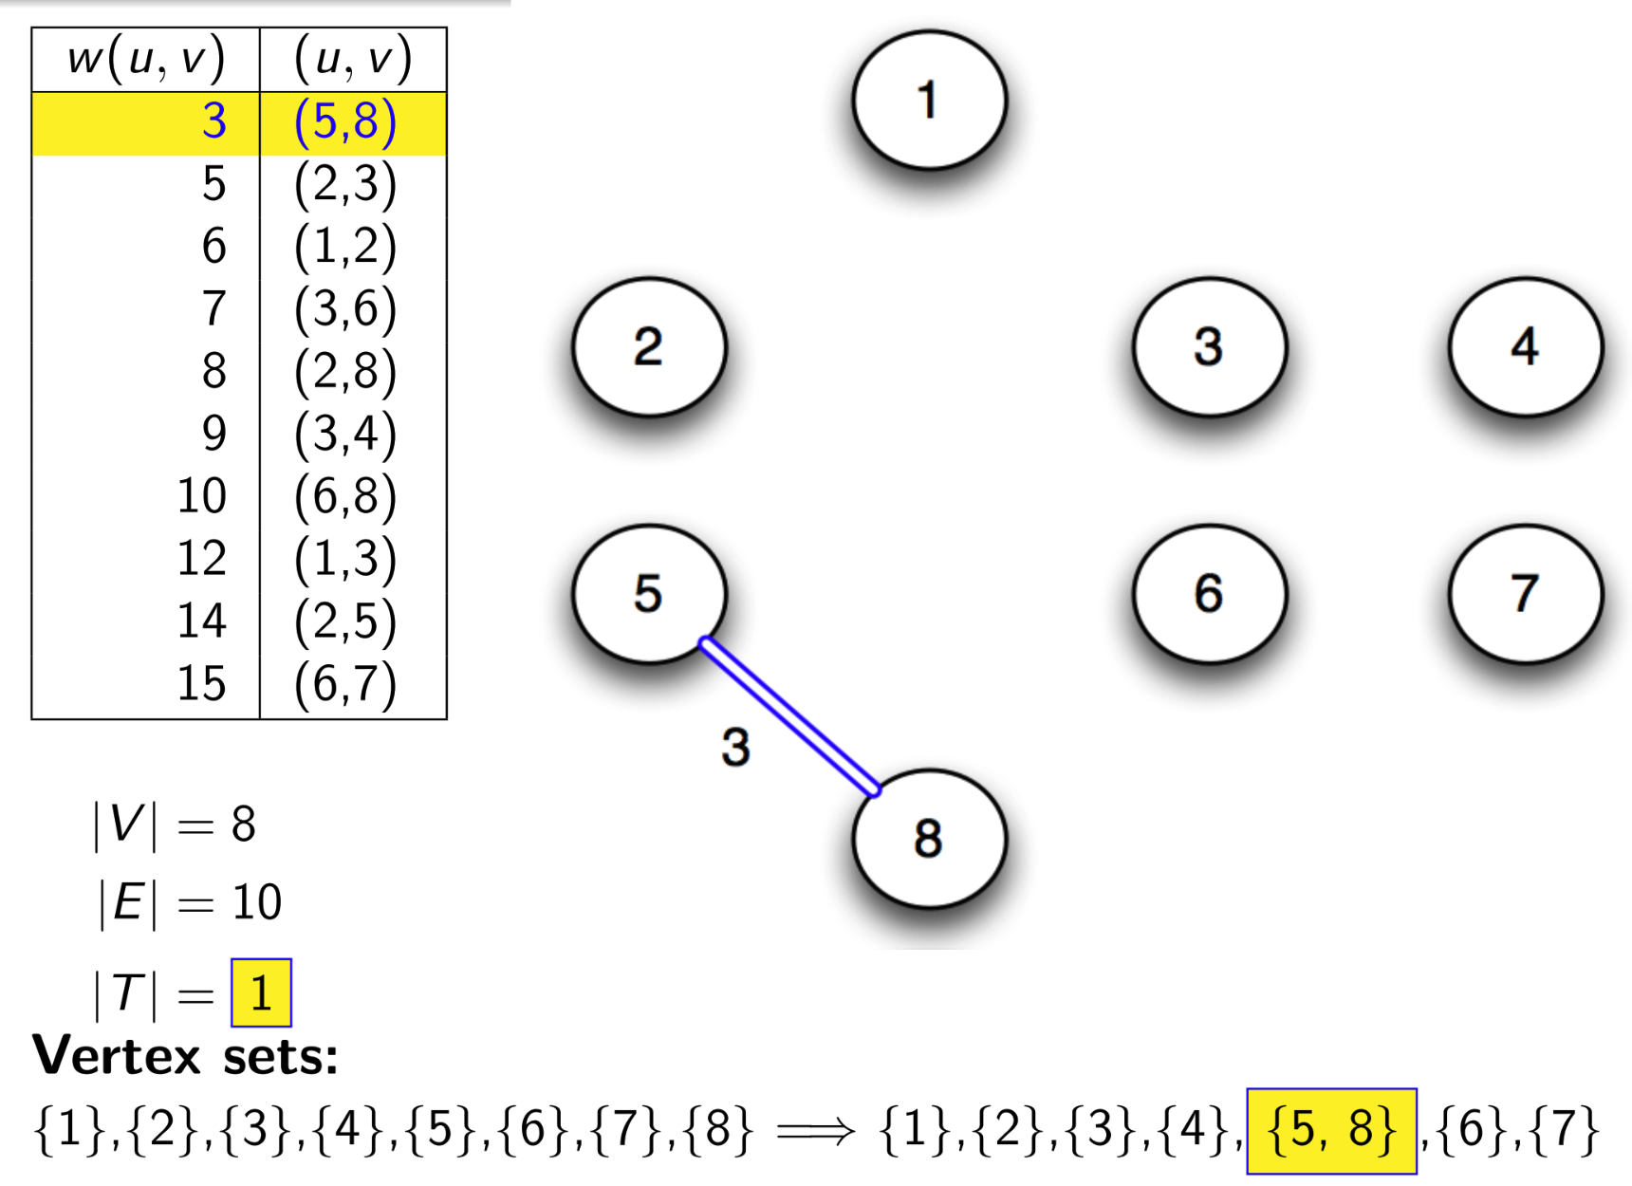
Kruskal’s Algorithm (Simulation)

Slide 16
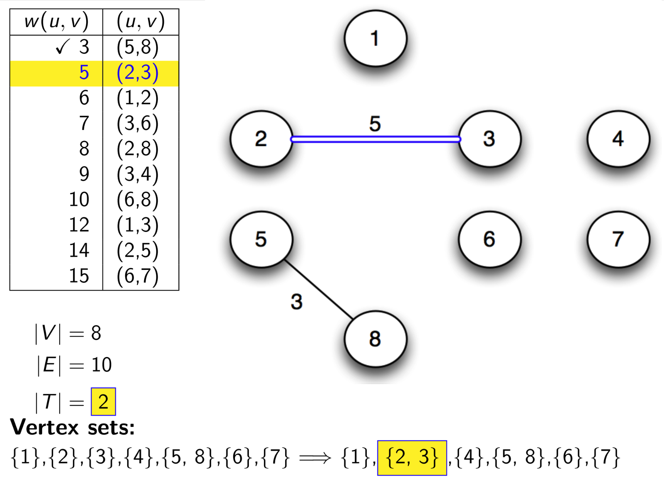
Kruskal’s Algorithm (Simulation)

Slide 17
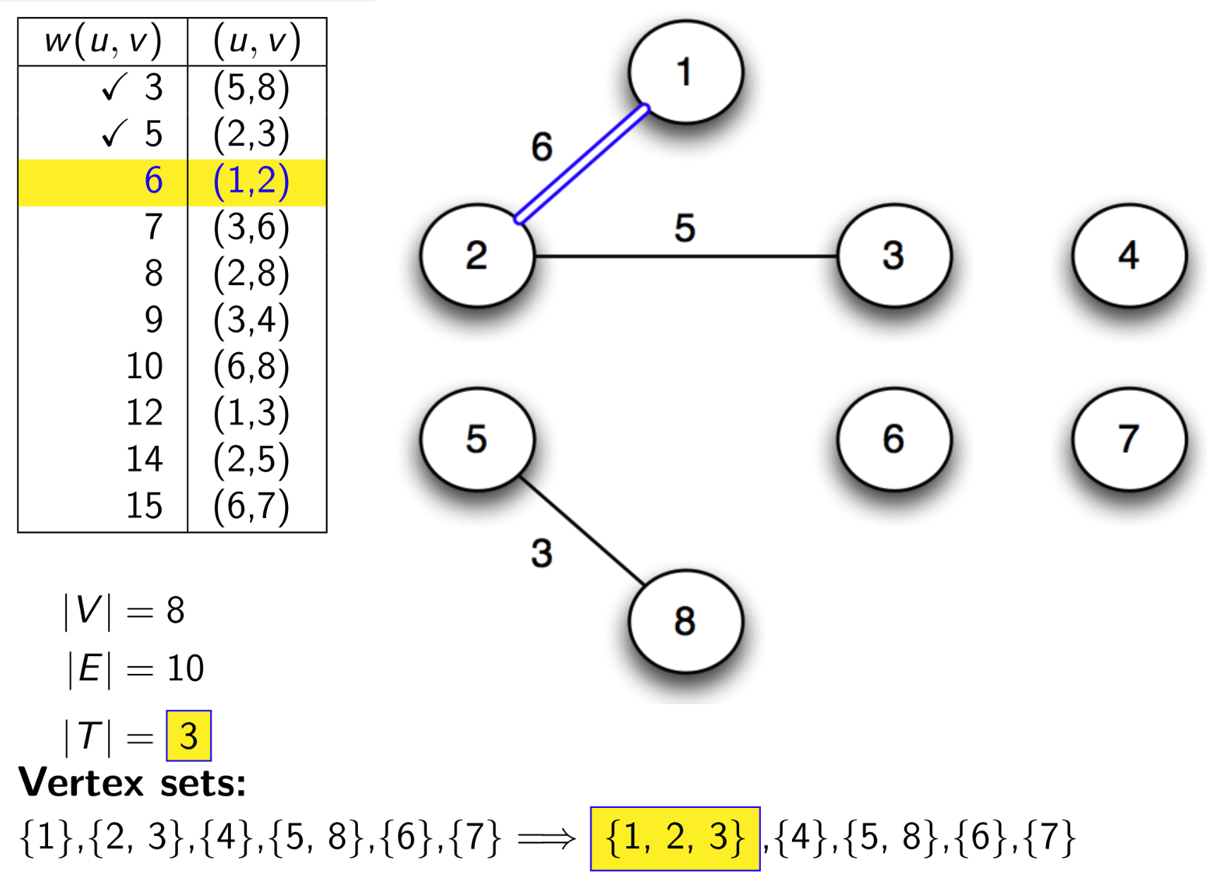
Kruskal’s Algorithm (Simulation)

Slide 18
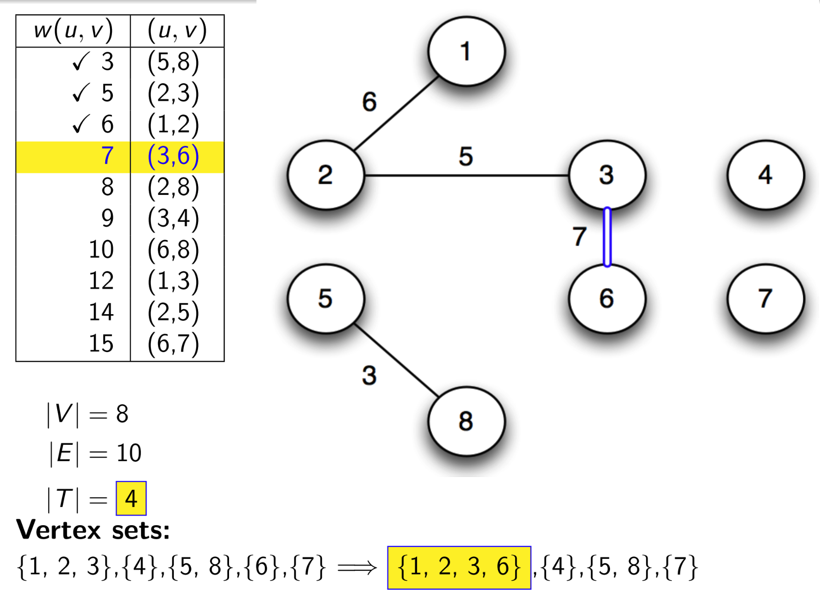
Kruskal’s Algorithm (Simulation)

Slide 19
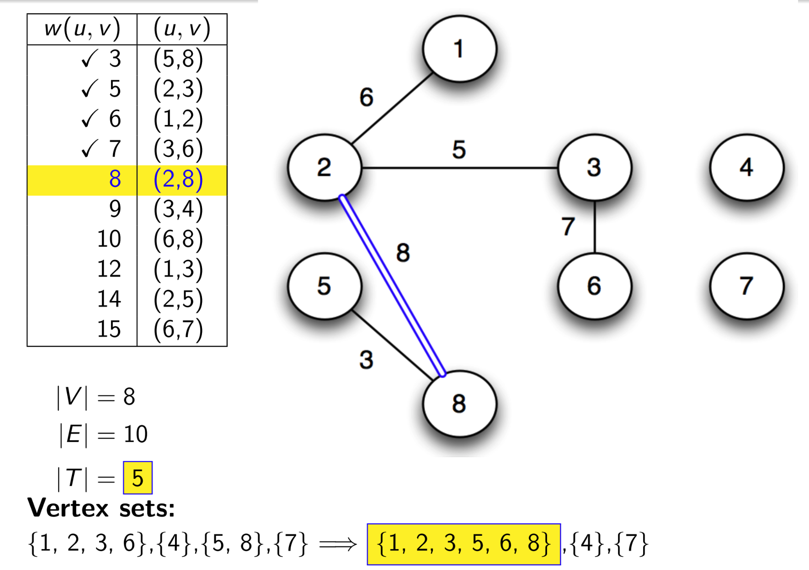
Kruskal’s Algorithm (Simulation)

Slide 20
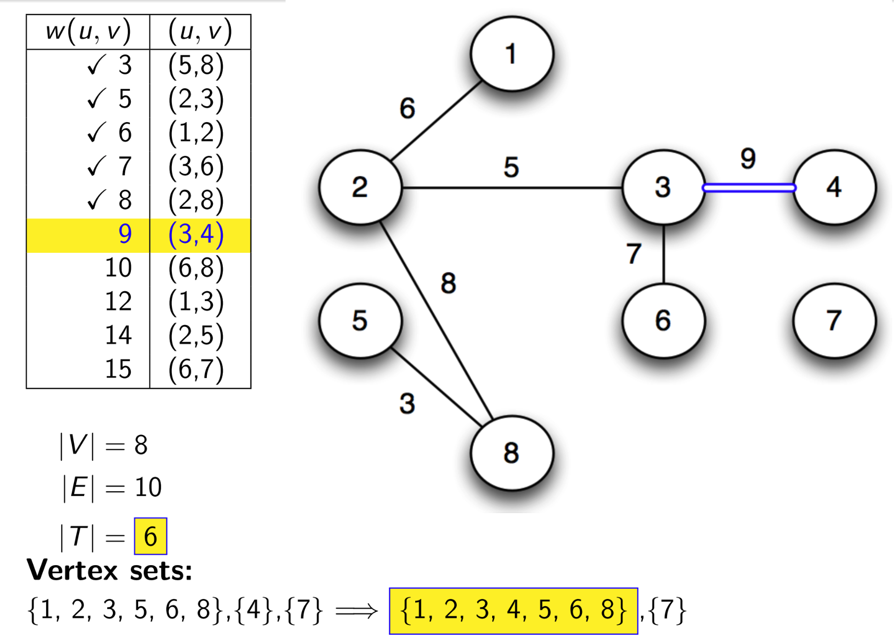
Kruskal’s Algorithm (Simulation)

Slide 21
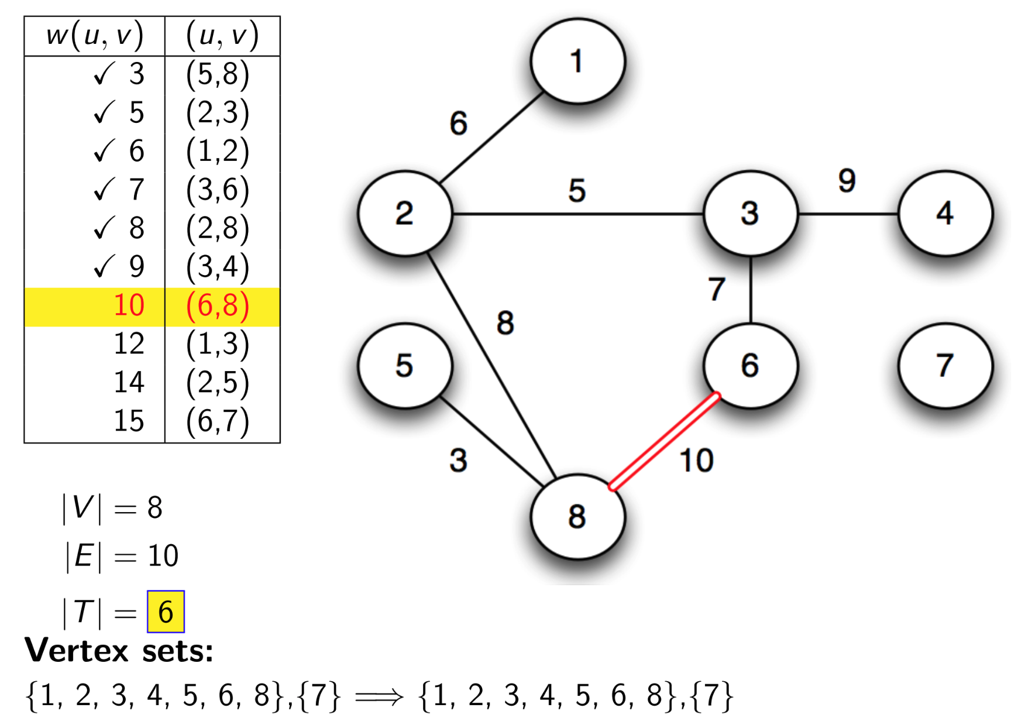
Kruskal’s Algorithm (Simulation)

Slide 22
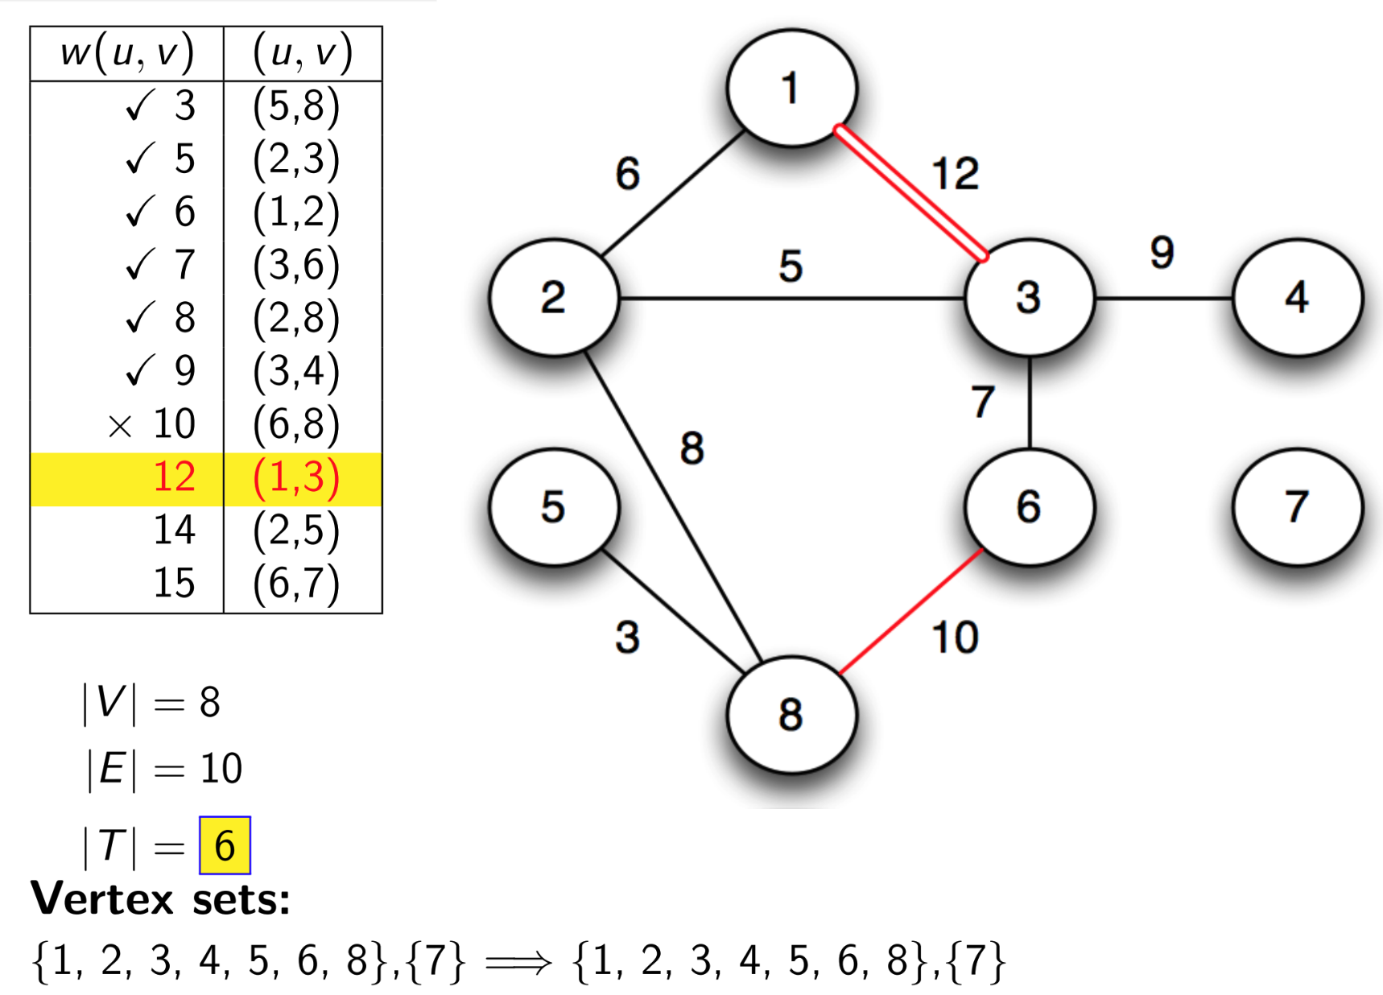
Kruskal’s Algorithm (Simulation)

Slide 23
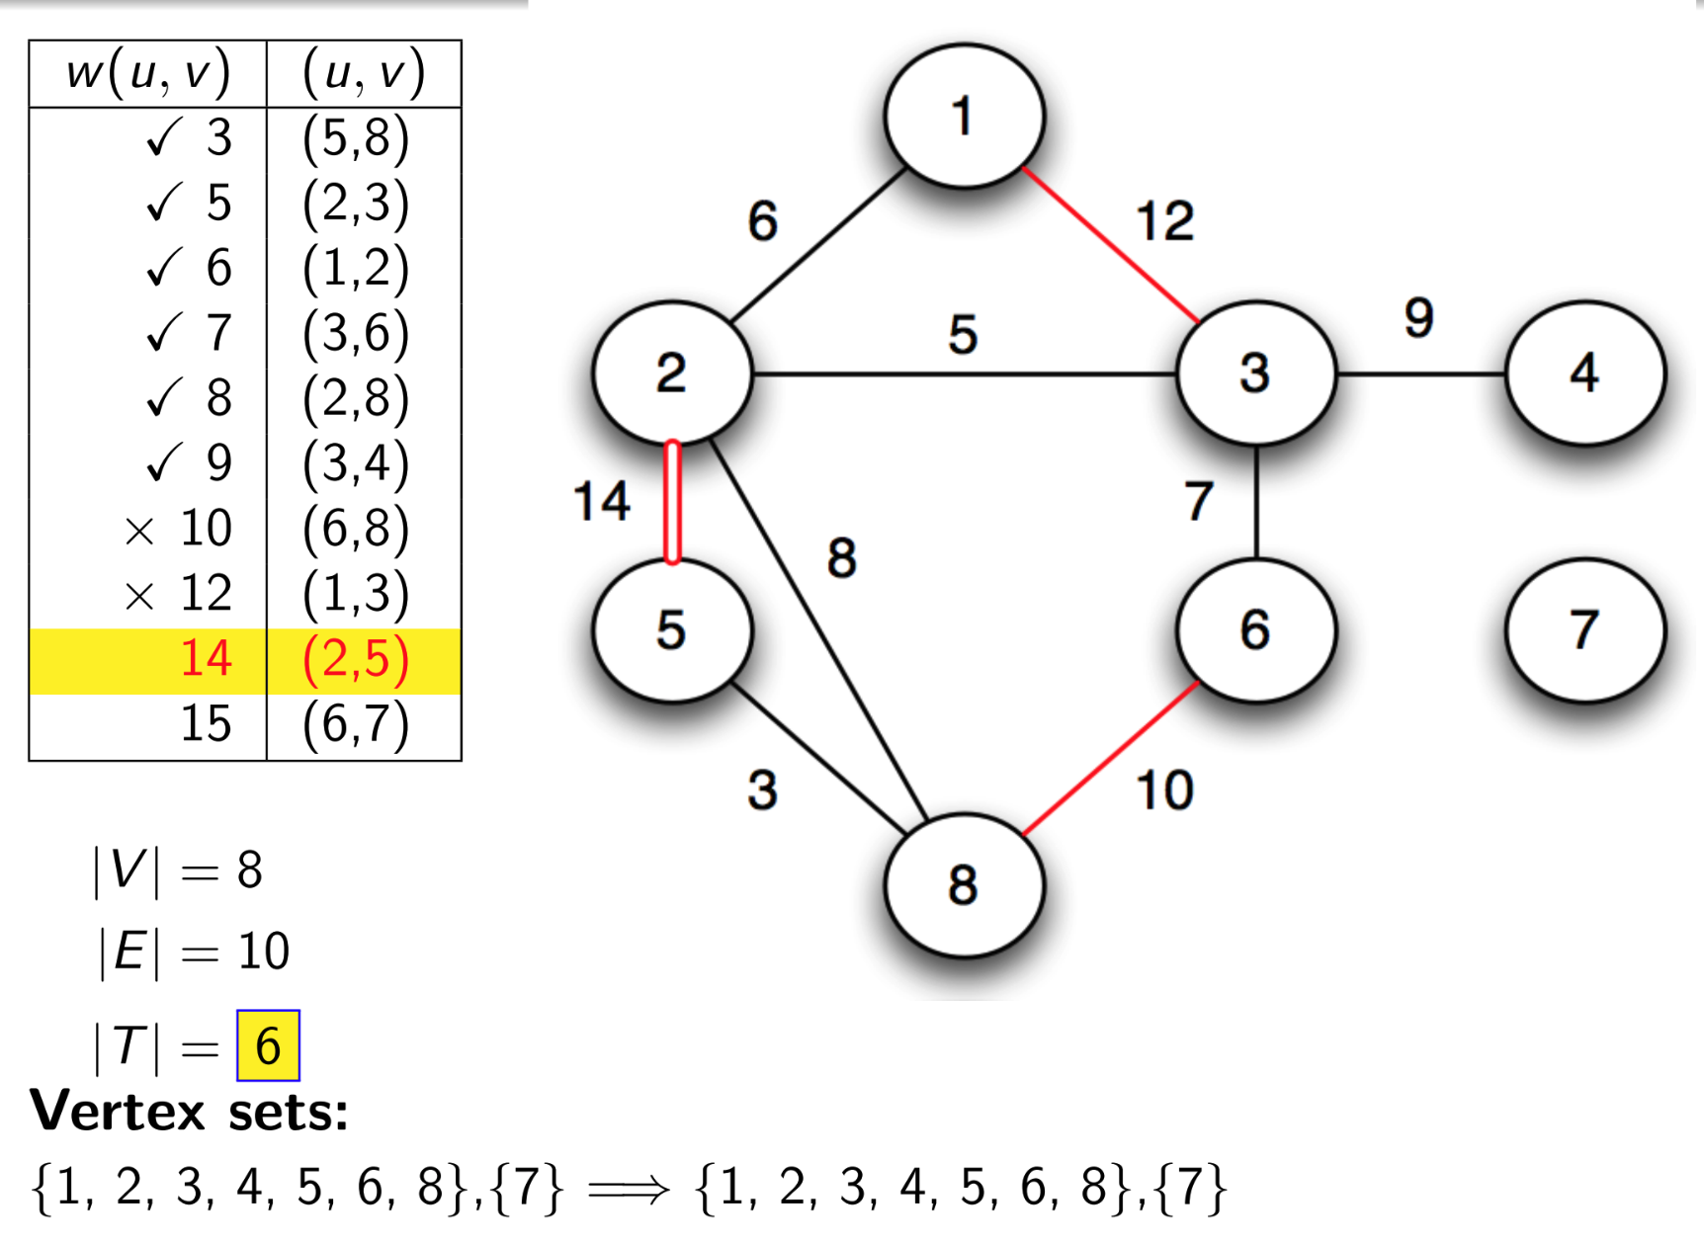
Kruskal’s Algorithm (Simulation)

Slide 24
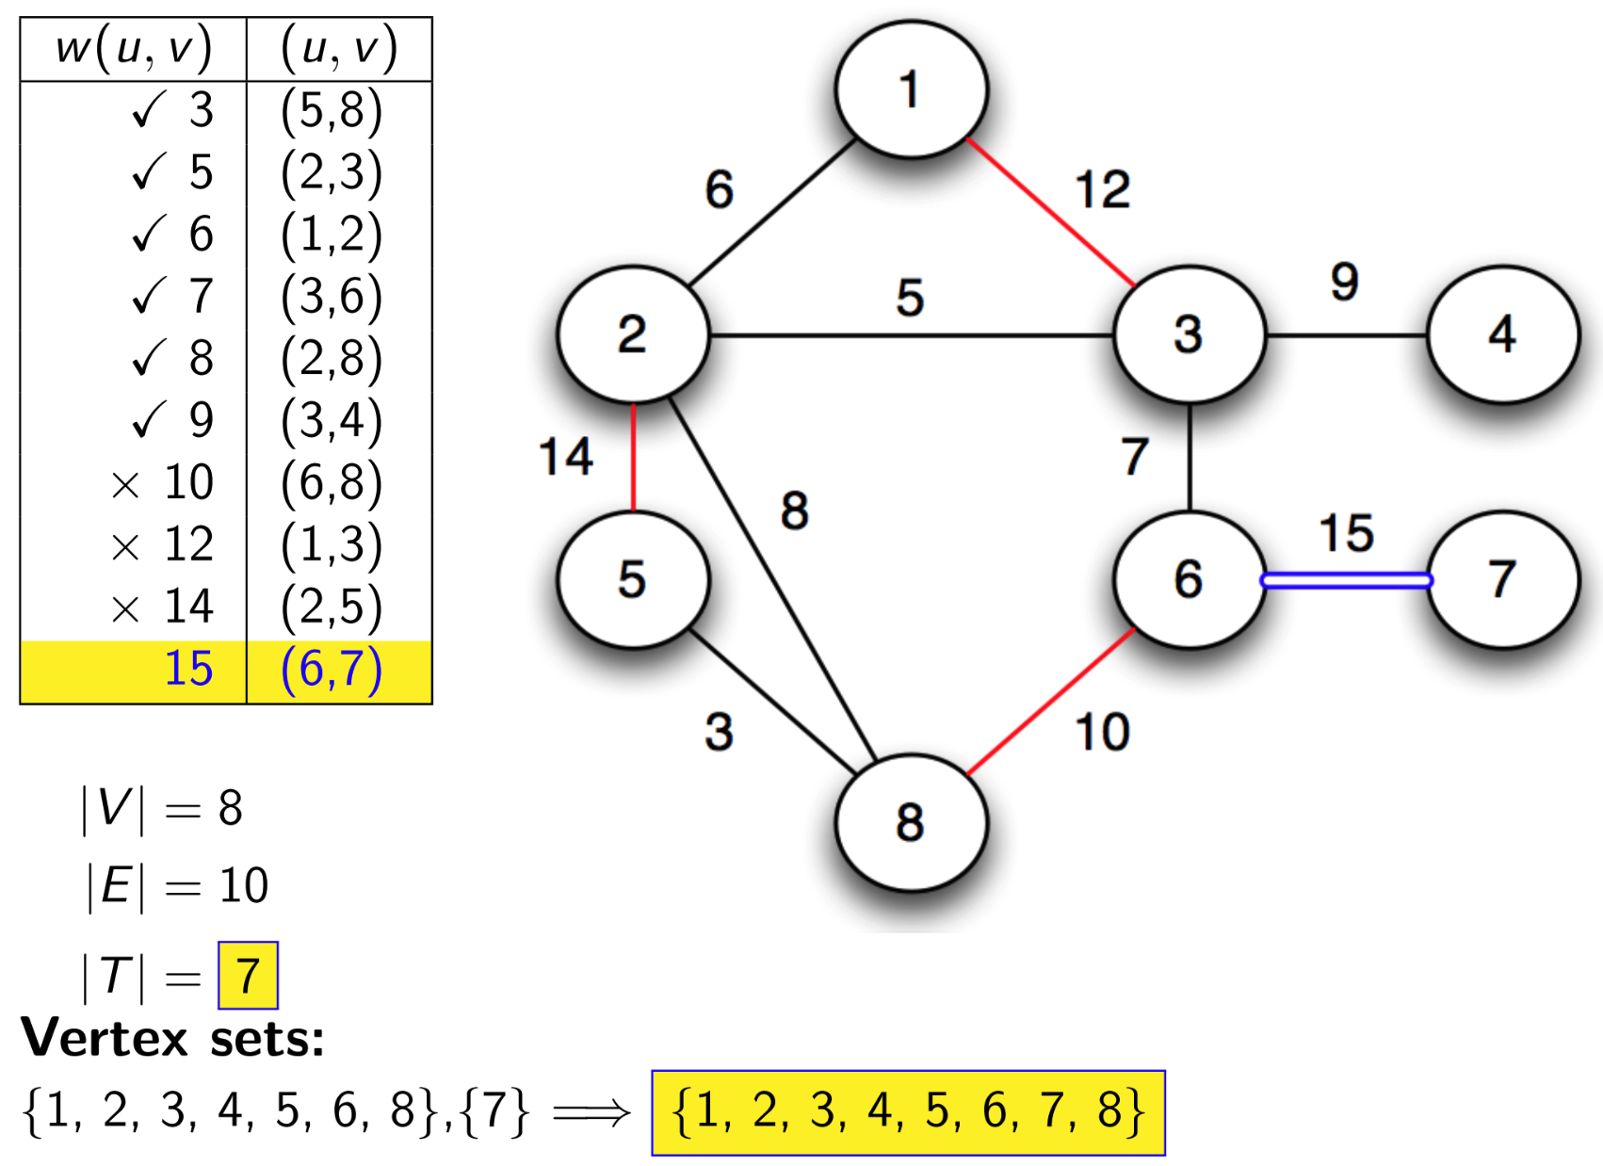
Kruskal’s Algorithm (Simulation)

Slide 25
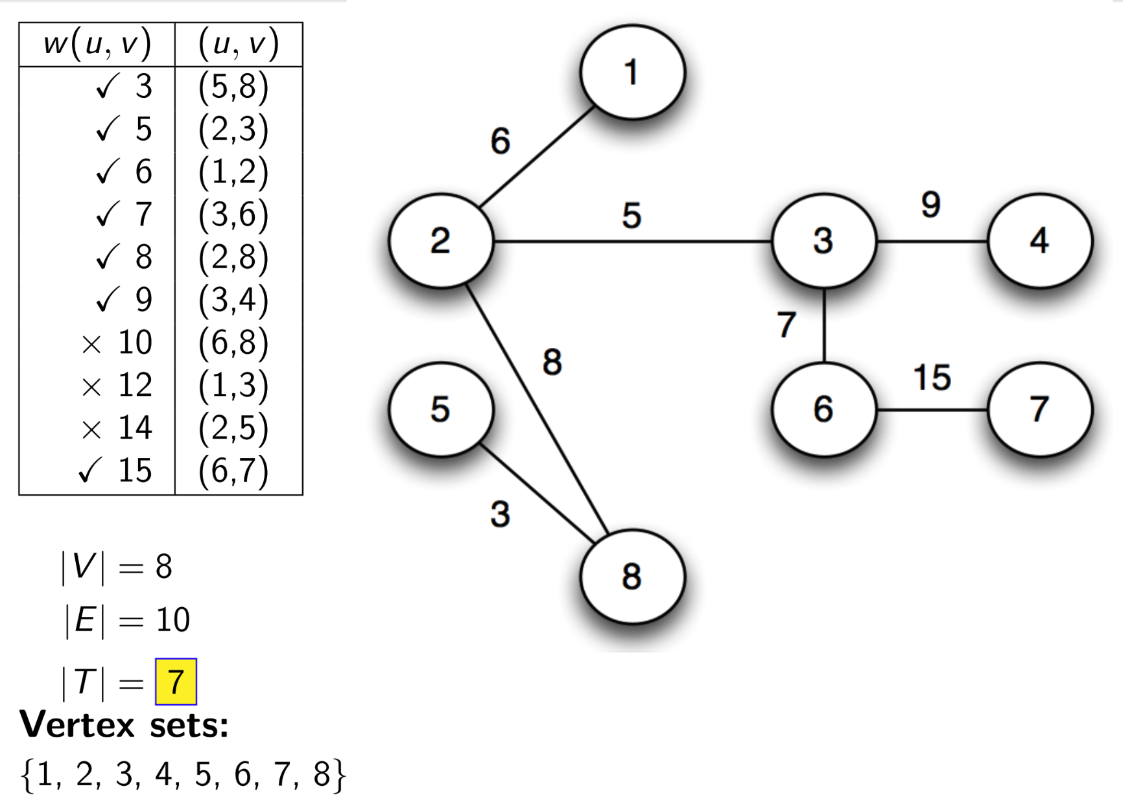
Kruskal’s Algorithm (Simulation)

Slide 26
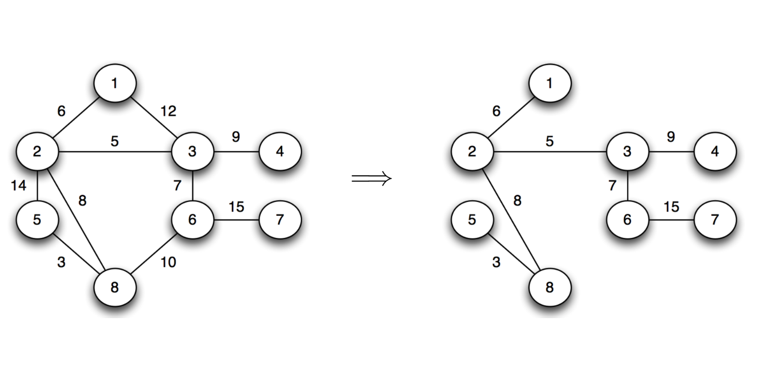
Kruskal’s Algorithm (Simulation)

Slide 27
Approach
Kruskal’s Algorithm follows the Greedy Approach to find the MST in a weighted and undirected graph. At every step of the solution, Kruskal’s algorithm picks the edges with the with the least cost/weight unless it makes a cycle. (i.e. greedy choice).
For this graph, Kruskal will choose the edge (a, b) first because it has the least cost/weight. Then it will choose either edge (a, d) or edge (b, d) as both has same cost/weight. In this way, it will choose least cost/weighted edges unless it makes a cycle and will eventually build up the MST (i.e. greedy approach).

Slide 28
Properties
Time Complexity: O(E log E)
Sorting edges takes O(E log E) (where E = number of edges).
Union-Find operations take almost constant time (O(α(V)), inverse Ackermann function, which is very small).
Space Complexity: O(E + V)
Storing sorted edges takes O(E) space.
Union - Find operations takes O(V) space for rank/parent array.
Follows greedy approach
Uses Disjoint Set Union (DSU) or Union-Find data structure to efficiently check whether adding an edge forms a cycle.
If the graph is not connected, it produces a Minimum Spanning Forest (MST for each component).
Does not work for directed graphs as path can not be guaranteed.

Slide 29
Reference
Graph Algorithms by Mumit Khan
https://drive.google.com/file/d/1MCbK6w6tSITZ3UrV9Na4-tPTolKXjO3D/view?usp=sharing

